Slide 1
Inside Sherpa Example: Chips – Snack Foods
June 2020
Brand note: If client logo is not required, use alternate title page layout right click slide thumbnail > Layout > Title

Slide 2
Notes:
To view Privacy video explaining how important data privacy is to Quantium, please click here: https://www.youtube.com/watch?v=Zq1QDAkoRzU
or here Q:\Company Reference\Brand & Design\Brand videos\Q Privacy.mp4
At Quantium, we believe that data is the behavioural footprint of humanity and that it has to be treated with the utmost care and responsibility.
Histories, attitudes, indeed lives are stored within it in ways that aren’t always apparent – and that’s what makes its potential so powerful.
To work with it responsibly, sensitively, we set ourselves the highest data privacy protection and governance standards.
We have spent 17 years perfecting privacy-by-design and secure-by-design principles. Central to this is not holding any personally identifiable information about people –
we neither receive it, and put the necessary protections in place to be unable to decipher it.
Every aspect of handling data is safeguarded: from its de-identification, to its encryption – data security is paramount and of the highest grade.
We pride ourselves on gaining the trust of iconic organisations around the world through years of securely working with their data,
and in turn the trust that builds with their stakeholders.

Slide 3
Executive summary
01
Chips Category Review
The number of chips transactions dramatically increases prior to Christmas. Thus, added visibility to customers via a promotional display or Gondola end would increase purchases driving sales growth over this holiday period.
Mainstream Young Singles & Couples are the primary shopper of chips.
Young and Older Families make up 26% of Chips shoppes and on average purchase larger baskets. There is more opportunity for sales with these shoppers.
02
Trial Store Analysis
A control store was constructed to reflect the prior performance of the selected trial store.
After implementing the new store layout the performance of the trial store and the control store were compared. The trial store saw significant uplift from the new store layout.

Slide 4
01
Category

Slide 5
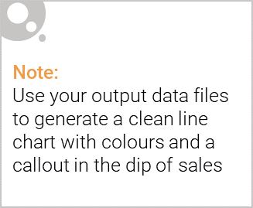
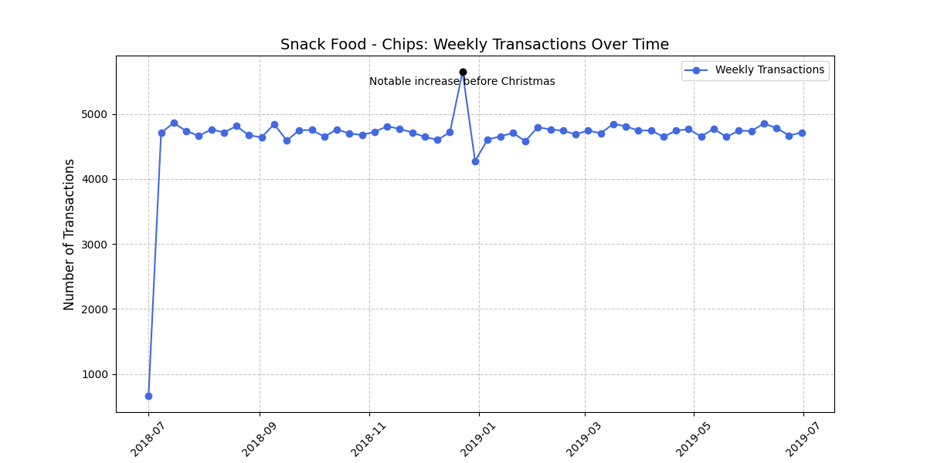
The number of Chips transitions has remained relatively consistent over the last 52wks; a notable increase occurred in the week leading up to Christmas
Snack Food - Chips – Weekly transactions over time

Slide 6

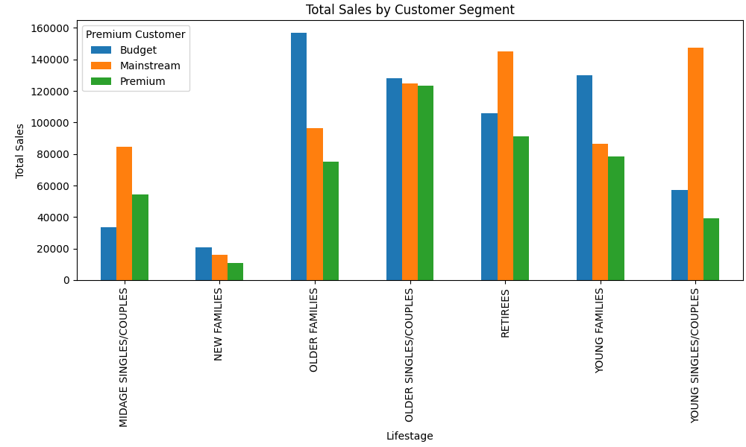
Affluence appears consistent across each individual life stage profile; Older and Young Family shoppers purchase the highest Total Sales
Snack Food -Chips –Total Sales by affluence and life stage profile

Slide 7
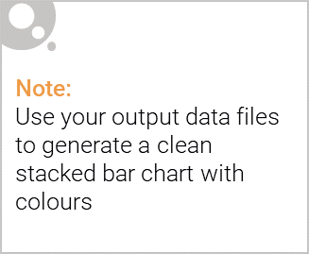
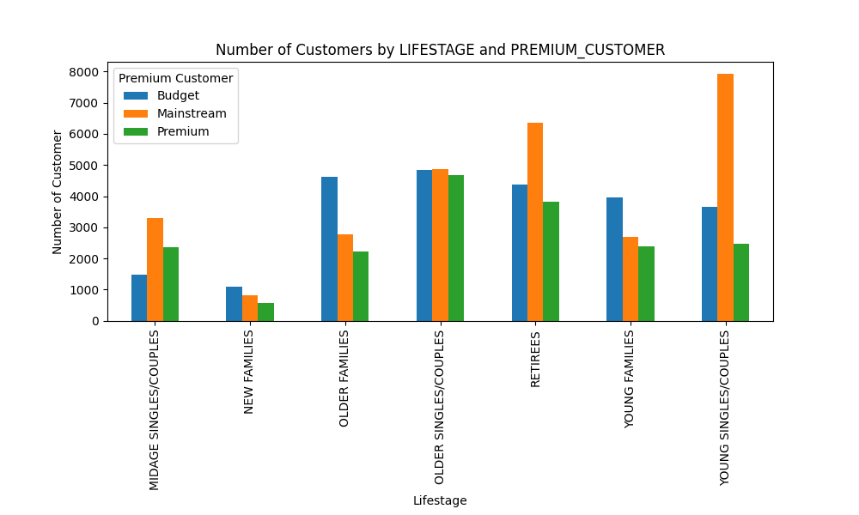
Editable (delete this)
Mainstream Young Singles & Couples make up the largest proportion of Snacking Chips shoppers; Mainstream Retirees also have a significant share
Snack Food -Chips –Proportion of Customers by affluence and life stage profile

Slide 8
02
Trial store performance

Slide 9
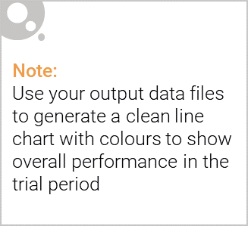
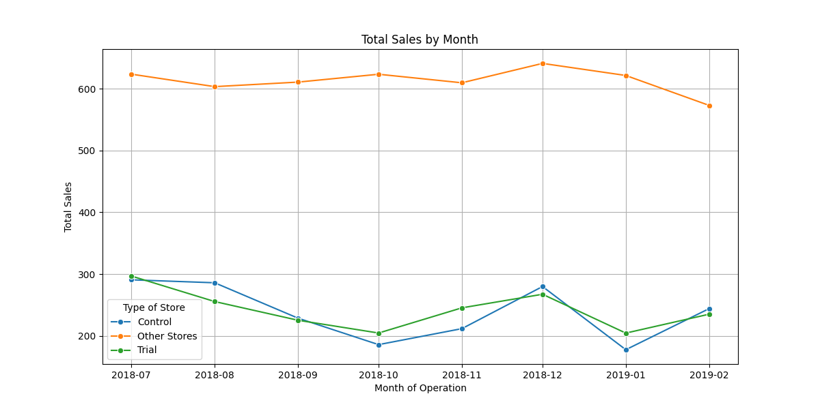
The control store is constructed to reflect performance of the trial store rather than the average of other store
Snack Food - Chips – Avg monthly store sales over time

Slide 10
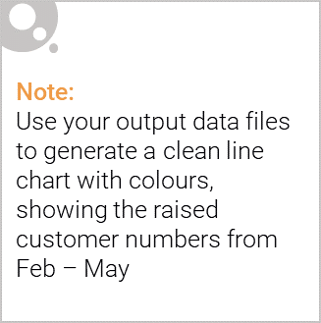
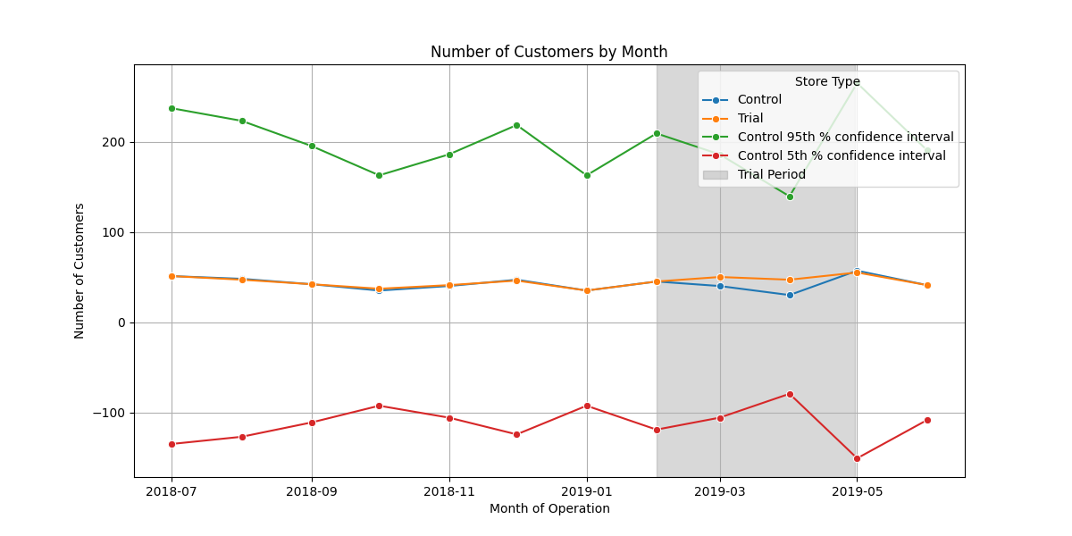
From Feb to May the trial store outperformed the control store highlighting the success of the new store layout
Snack Food –Chips –Number of customers over time

